Slide 1
World History and Geography 2020-21
Unit 1
Age of Revolution
1750-1850

Slide 2
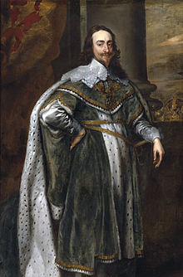
Module 1: Absolutism, Divine Right of Kings, and the English Civil War
Day 1
Absolutism
Charles I of England

Slide 3
How did people become kings?

Slide 4
Power of the Monarchy

Slide 5
Divine Right of Kings
The belief that kings were bestowed their authority by God.
Gave political legitimacy to monarchs.

Slide 6
Absolutism /ˈabsəl(y)o͞oˌtizəm/
The political doctrine and practice of unlimited centralized authority and absolute sovereignty, as vested especially in a monarch or dictator.
Ruler has complete control over his/her subjects.

Slide 7
Rise of Absolutism
Prior to 1500s, the Church held immense power and influence over European monarchies.
Due to the Reformation the Church began to lose power in the early 1500s.

