Slide 1
World History and Geography 2020-21
Unit 1
Age of Revolution
1750-1850

Slide 2
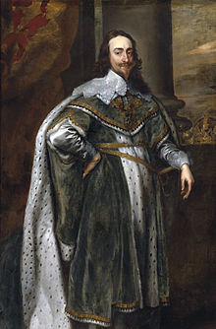
Module 1: Absolutism, Divine Right of Kings, and the English Civil War
Day 4
The Magna Carta and the English Bill of Rights
Charles I of England

Slide 3
Background
Magna Carta
Written by nobles who wanted personal freedom
More of a peace treaty
English Bill of Rights
Written mainly in response to James II’s religious intolerance.

Slide 4
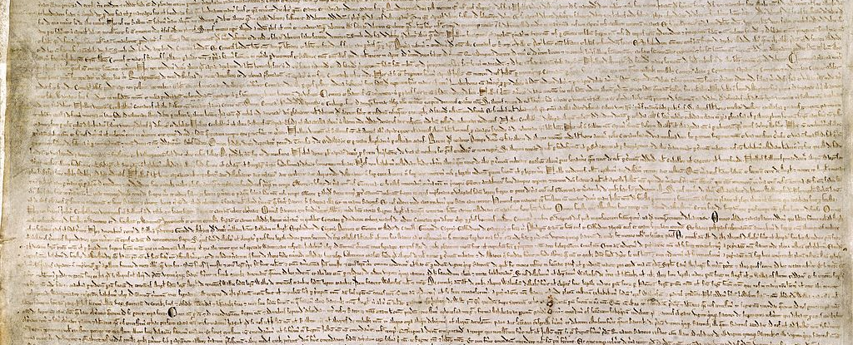
Magna Carta
Written in 1215
Nobles rebelling against monarchy
Trial by jury, no taxes without consent, effective legal system, and property rights
Began to limit king’s power.
Did not provide rights for all people.

Slide 5
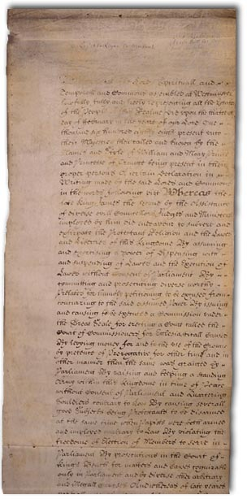
English Bill of Rights
Written in 1689
Response to James II
Freedom of religion, end of cruel and torturous punishments.
Built upon ideas found in the Magna Carta.
Demanded set of rights.
Parliament always stronger than monarch.

