Slide 1
Imperialism in Africa

Slide 2
Do Now (5 min)
Write 3 sentences describing the motivations for “new imperialism” that we read on Tuesday in Chapter 12, Lesson 1 and from “White Man’s Burden”
Motivations:
National prestige
Race for raw materials
Social Darwinism
Rivalries between European countries

Slide 3
3-2-1 (5 min)
Complete a 3-2-1 in your guided notes about imperialism
3 things you learned
2 things you enjoyed
1 thing you still have a question about

Slide 4
Nationalism and Unification CFA
Complete the CFA on Nationalism and Unification in Teams. This will also help you to review for the test tomorrow. If you can’t take it in Teams, I have paper copies available (white basket)
Remember, this is to help us generate data. No guided notes, but please try your best. This will not count for a grade. Tomorrow’s test will count as your 4th Assessment grade, and you can use your guided notes

Slide 5
Assessment #4 – Nationalism and Unification
Access your final test for Q1 via Teams. If you are unable to use Teams, grab a paper copy from the white basket
You may use your guided notes as well as your book to take the test
Once you finish, please make sure you have all of your work caught up in my class. The quarter ends next Friday, but I am cutting off work submissions on 10/06/21 – Wednesday of next week.

Slide 6
SWBAT develop geographic awareness by analyzing interactions between humans and the environment IOT describe the natural resources and geographic features of Africa, their role in attracting European economic interests, and their impact on global trade.
Do Now (3 min)
Write 4 sentences in your guided notes describing two different ways that European countries were able to successfully colonize Africa.

Slide 7
SWBAT develop geographic awareness by analyzing interactions between humans and the environment IOT describe the natural resources and geographic features of Africa, their role in attracting European economic interests, and their impact on global trade.
Open your Modern Times book to Chapter 12 – Lesson 2
Read pages 231-236
Write the vocabulary words annex and indigenous and their definitions into your guided notes

Slide 8
4 Corners Group Discussion
Go to your group’s area.
Discuss your group’s assigned reading section for 5 minutes
Select a group member to summarize your section to the class
Left side of classroom – Group 1 – West and North Africa
Front middle – Group 2 – Central and East Africa
Back middle – Group 3 – South Africa
Right side of classroom – Group 4 – Effects of Imperialism

Slide 9
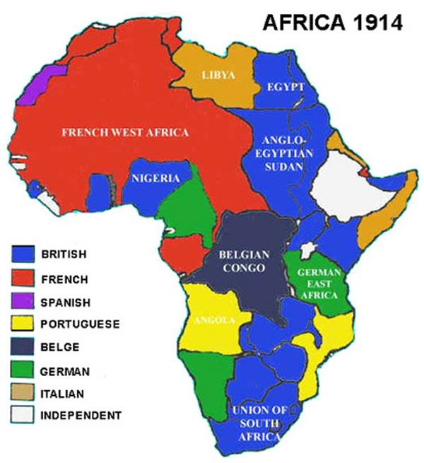
SWBAT develop geographic awareness by analyzing locations IOT describe the importance of India to the British Empire, the Suez Canal as a connection between Great Britain and India, and India’s reaction to British rule.
Do Now
List two examples of European imperialism on two different continents.
What was the response of the indigenous peoples in each example?

Slide 10
SWBAT develop geographic awareness by analyzing locations IOT describe the importance of India to the British Empire, the Suez Canal as a connection between Great Britain and India, and India’s reaction to British rule.
Open your Modern Times book to Chapter 12 – Lesson 3
Read pages 237-241
Write the vocabulary words sepoy and viceroy and their definitions into your guided notes

Slide 11
4 Corners Group Discussion
Go to your group’s area.
Discuss your group’s assigned reading section for 5 minutes
Select a group member to summarize your section to the class
Left side of classroom – Group 1 – The Great Rebellion
Front middle – Group 2 – British Colonial Rule
Back middle – Group 3 – Indian Nationalists
Right side of classroom – Group 4 – Colonial Indian Culture

Slide 12
Exit Ticket
Submit the answers to the review questions 1, 3, 4, 5, and 6 on page 241 of your Modern Times book
You may attach a word document in Teams or take a picture of your written answers. This will be your first participation grade for Q2

Slide 13
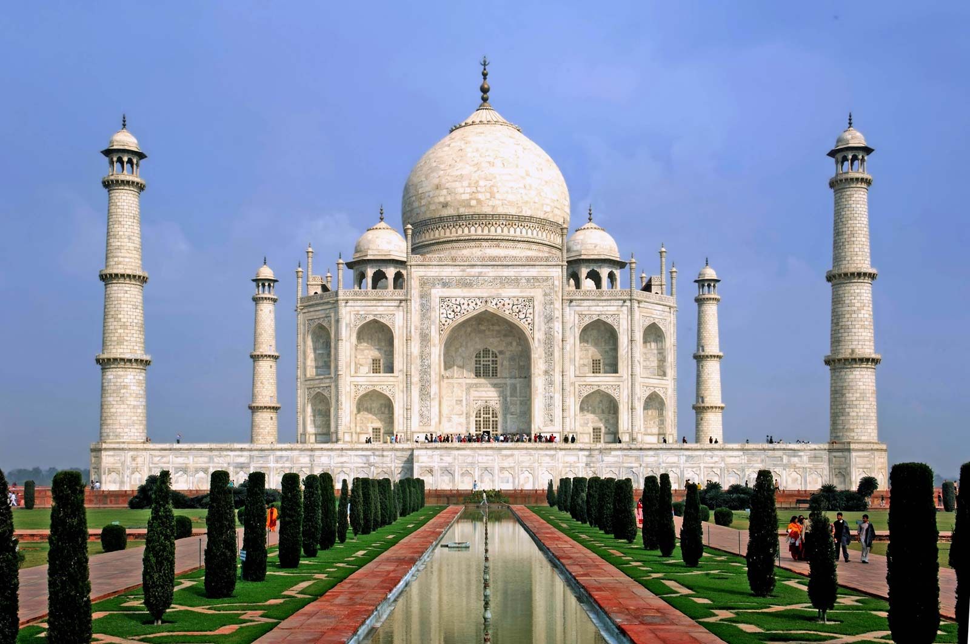
SWBAT develop geographic awareness by analyzing locations IOT describe the importance of India to the British Empire, the Suez Canal as a connection between Great Britain and India, and India’s reaction to British rule.
Do Now
What were two positive effects of British colonization in India?
What were two negative effects?
What was the feeling Indian people had towards the British Empire?

Slide 14
Review of Chapter 12 – Lesson 3
The Great Rebellion
British Colonial Rule
Sepoys were Indian soldiers hired by the East India Company to protect their interests in the region
Due to a violation of religious beliefs, a group of sepoys revolted
Religious differences made it tough for Indians to organize
EIC is eventually transferred directly to the British government
Built infrastructure in India (schools, railroads, postal service, hospitals)
Mainly trained young Indians to work for the British government
Mass starvation as many farmers were asked to grow cotton instead of food

Slide 15
Review of Chapter 12 – Lesson 3 (Con’td)
Indian Nationalists
Colonial Indian Culture
Creation of the INC (Indian National Congress)
Only wanted reform, not outright revolution
Religious differences made it tough to unify
Rise of Gandhi as a major leader in the non-violent resistance of British rule that eventually leads to Indian independence
Great Britain not respectful of Indian culture (Taj Mahal)
A love-hate relationship
Promotion of Indian nationalism to those who didn’t speak English

