Slide 1
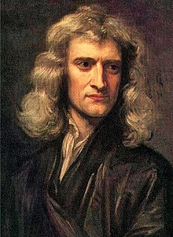
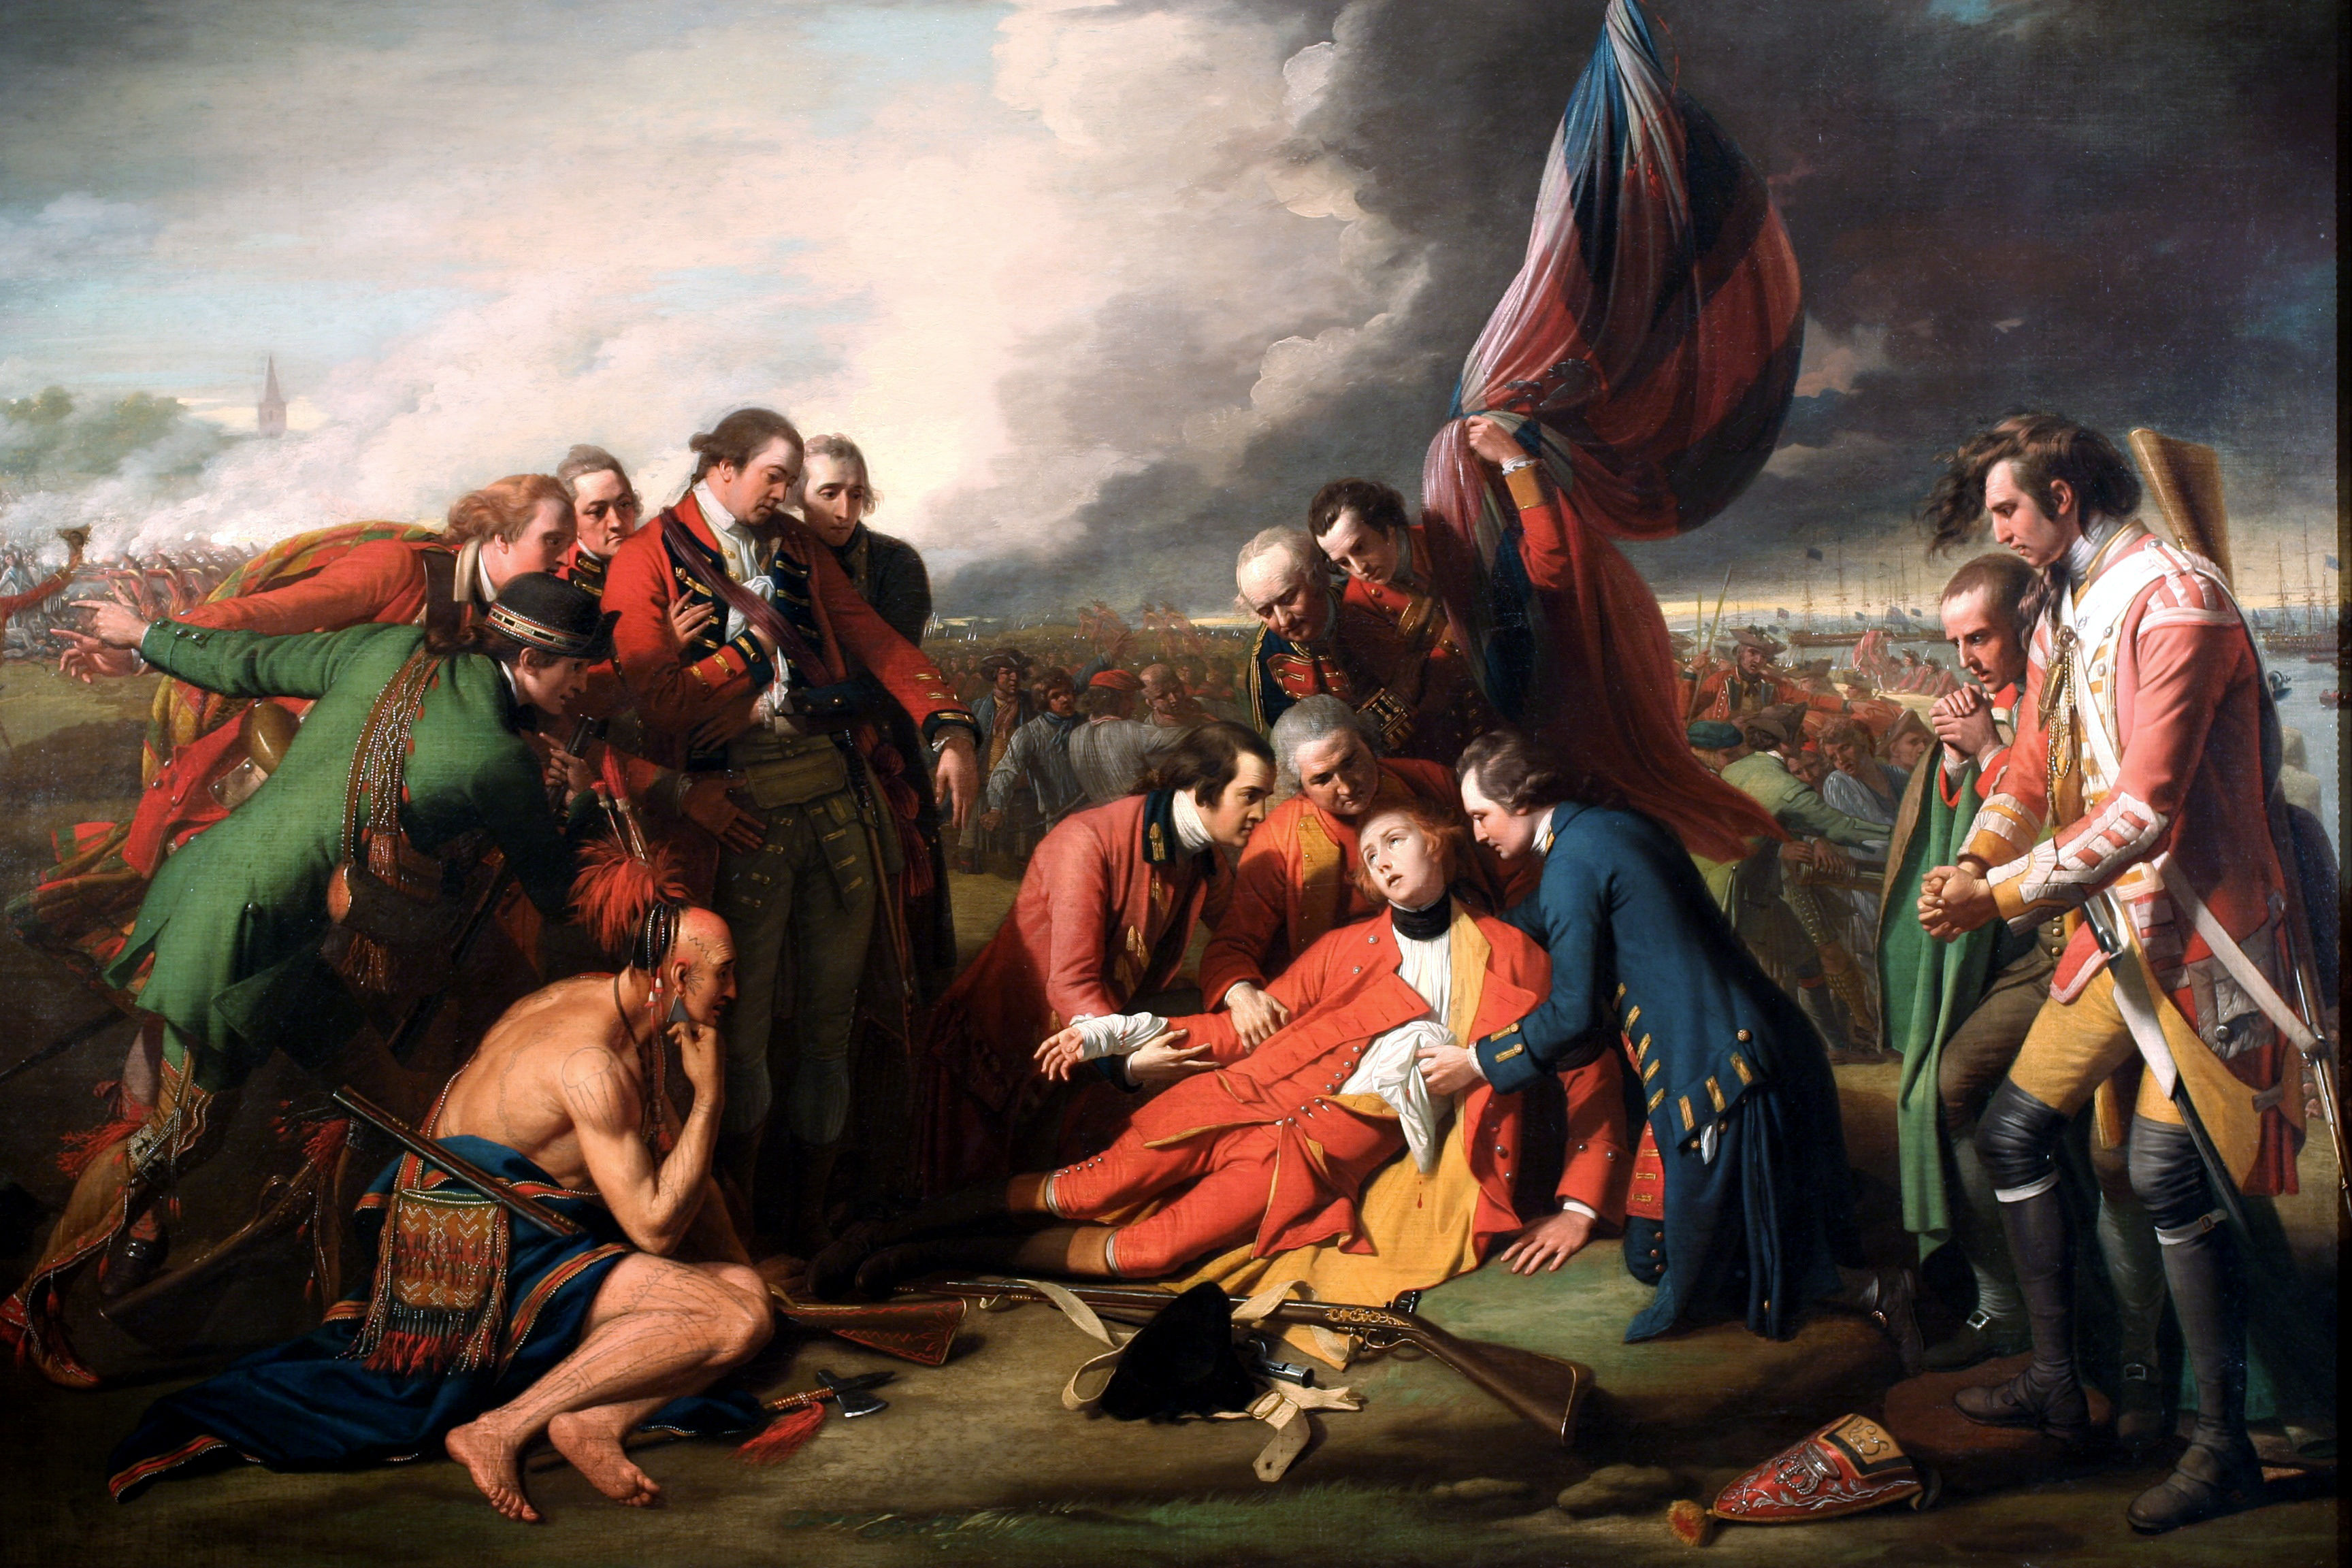
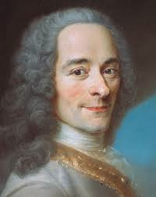
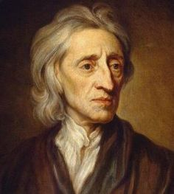
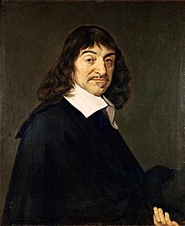
The Enlightenment
Cognito ergo sum

Slide 2
Bell work
Are humans born with any natural rights? What are they?
Write 4-5 sentences about the natural rights humans are born with. Be prepared to discuss with the class

Slide 3
Rise of the Enlightenment
Science
Move away from reliance on the divine
Move toward creating theory based on observation and rationalism.
Philosophy and Society
Response to absolutism and the divine right of kings
English Civil War

Slide 4
Rise of the Enlightenment
The Age of Reason
Mid 1600s – End of 1700s
Human reason glorified.
Actively sought to rid superstition
Human rights and democracies

Slide 5
Philosophes (Philosophers)

Slide 6
Descartes
Father of modern philosophy
Cognito ergo sum
I think therefore I am
The simple meaning of the phrase is that if one is skeptical of existence, that is in and of itself proof that he does exist.
Dualism
Mind and body

Slide 7
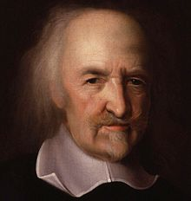
Thomas Hobbes
Political philosophy
Wrote Leviathan
Absolute monarchy was good.
Social Contract – basis of society and government
Give up some freedoms for protection
Wrote in response to the English Civil War
It was wrong to try to overthrow government

Slide 8
John Locke
Tabula rasa
Blank slate
Molded by experiences
Two Treatises of Government
Against absolute rule of one person
People were free before society
Natural Rights (life, liberty, and property)
Rights we’re born with

Slide 9
Reading and worksheet
Read the “Legal and Political Thought” section in Chapter 5 – Lesson 2 in your Modern Times book to review about Hobbes and Locke
Complete the Leviathan and Two Treatises of Government worksheet with a partner (paper or Teams is fine)

Slide 10
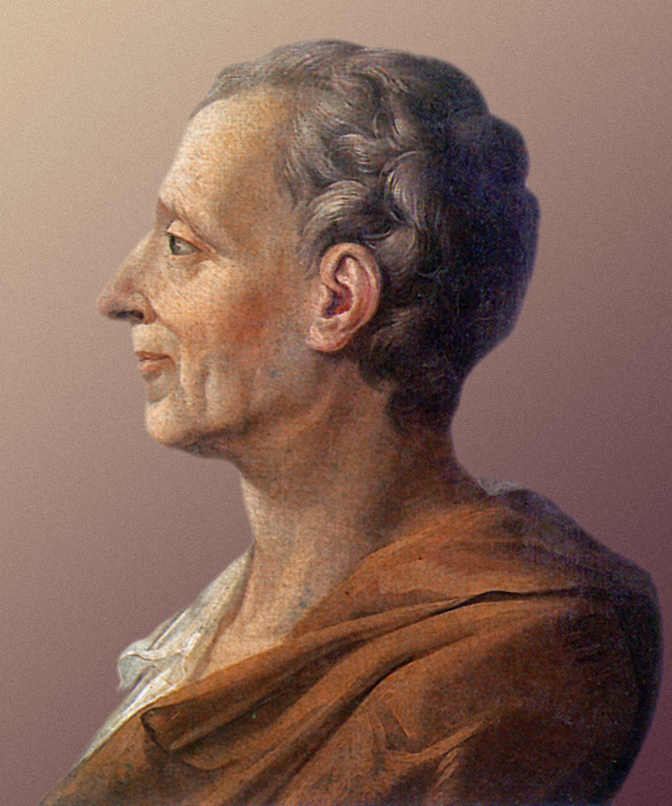
Charles-Louis de Secondat, Baron de La Brede et de Montesquieu

Slide 11
Or just Montesquieu

Slide 12
Montesquieu
Separation of powers
Legislative
Judicial
Executive
Despotism
Helped add this term into political
vocabulary.
Government in which one entity
rules with absolute power.

Slide 13
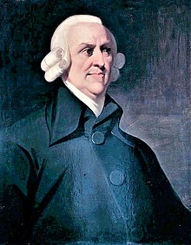
Adam Smith
Free market economic theory
Prices determined by open market and consumers
Free from government interference
Division of labor
Competition can create economic prosperity
Laissez-faire
Government should play small role in
free market economy

Slide 14
Voltaire
Critical of Christianity
(actually all religions)
Religious toleration
Fight against religious intolerance (intolerance is okay when fighting against intolerance)
Deism – religious philosophy based on reason and natural law
Built on Newton’s idea of world machine

Slide 15
Voltaire
Critical of Christianity
(actually all religions)
Religious toleration
Fight against religious intolerance
Deism – religious philosophy based on reason and natural law
"What is faith? Is it to believe that which is evident? No. It is perfectly evident to my mind that there exists a necessary, eternal, supreme, and intelligent being. This is no matter of faith, but of reason.”

Slide 16
Voltaire
Built on Newton’s idea of world clock
Universe like a clock
God = clock maker; made clock and set to run
No interference from God
Tolerance toward other ethnicities
Fair trial
Freedom of religion
Against slavery

Slide 17
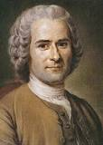
Rousseau
Wrote the Social Contract
Everyone free
Everyone gives up same freedoms
Same duties imposed on everyone
People have right to choose laws

Slide 18
Rousseau
Believed that uncorrupted morals exist in the “State of Nature”
Noble Savage – purity and goodness in the state of nature
Emile
Children inherently good
Influenced parents to start having kids play and have good childhood.

Slide 19
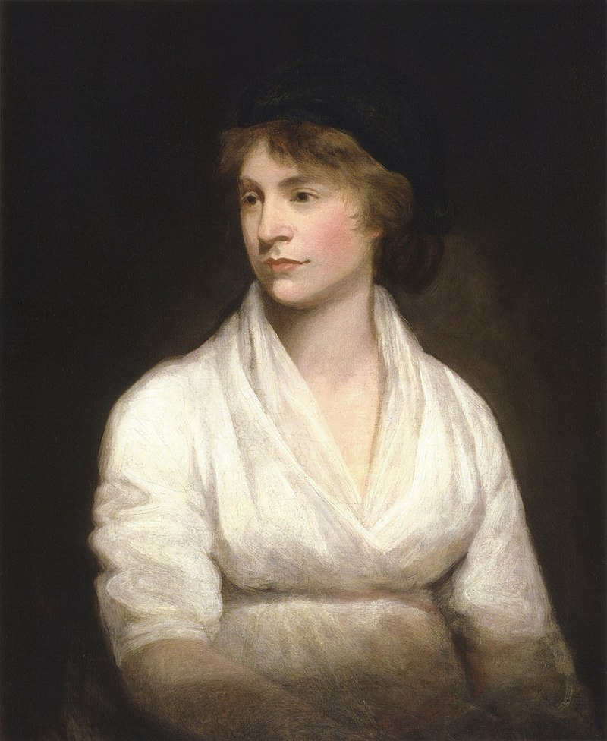
Mary Wollstonecraft
Vindication of the Rights of Women
Pushed against notions of womanhood
Didn’t have enough to preoccupy minds
Should be treated as rational people
Huge influence on society
Mother to Mary Shelley
Author of Frankestein

Slide 20
Enlightenment thinkers worksheet
Complete the worksheet
You can find it in Teams or fill out a paper copy, take a picture, and upload it to Teams
Chapter 8-2 and your guided notes should help you to find any information you will need to complete this assignment
Your comparative essay is due tomorrow! (8/25)
Make sure you get it done. Your classwork is 35% of your grade

